Slide 1

Module 1: Statistical Learning
Sep 8th, 2021

Slide 2
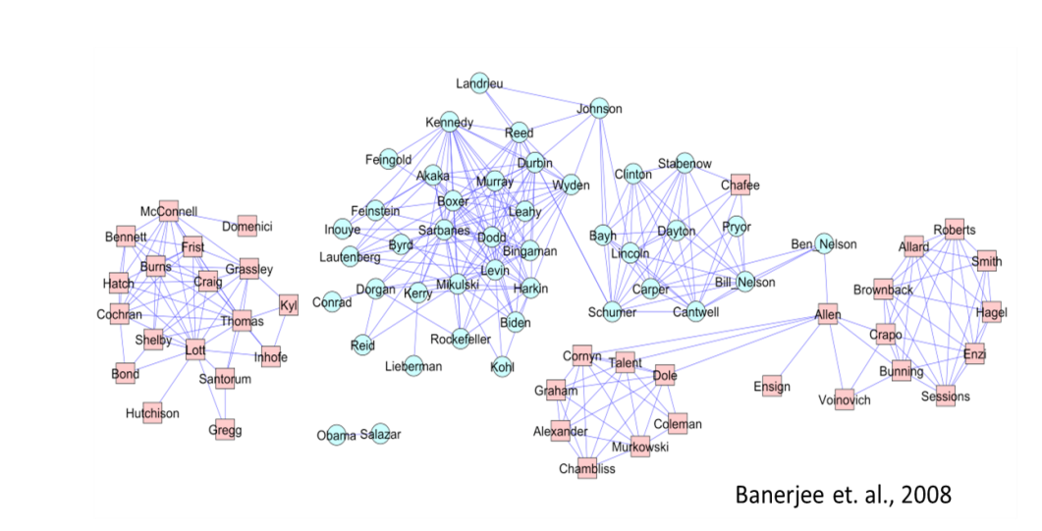

Slide 3
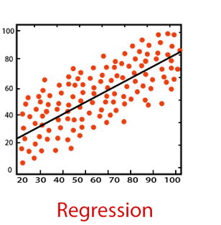
Recap: Supervised Learning
Inputs X and output Y both in the data.

Slide 4
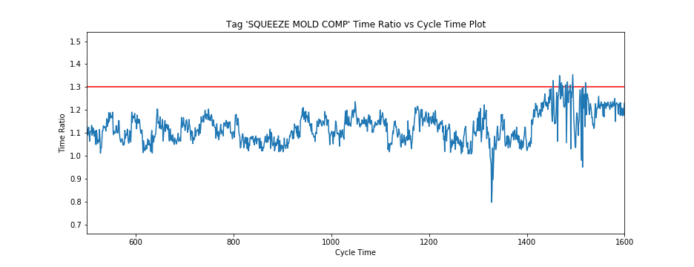
Predicting Failure time for a machine

Slide 5
Prediction Time
Observation Window
Prediction Window

Slide 6
Prediction Time
Observation Window
Prediction Window

Slide 7
Prediction Time
Observation Window
Prediction Window

Slide 8
Prediction Time
Observation Window
Prediction Window

Slide 9
Prediction Time
Observation Window
Prediction Window

Slide 10
Unsupervised Learning
We only have X in the data and want to output something not in the data

Slide 11
Unsupervised Learning
We only have X in the data and want to output something not in the data
 | Senate X | Senate Y | Senate XY | Senate Z
Bill 1 | 0 | 1 | 1 | 1
Bill 2 | 0 | 0 | 1 | 1
Bill 3 | 1 | 1 | 0 | 1
Bill 4 | 1 | 1 | 0 | 1
Bill 5 | 0 | 0 | 1 | 1
Bill 6 | 0 | 0 | 0 | 1

Slide 12
Unsupervised Learning
We only have X in the data and want to output something not in the data

Slide 13
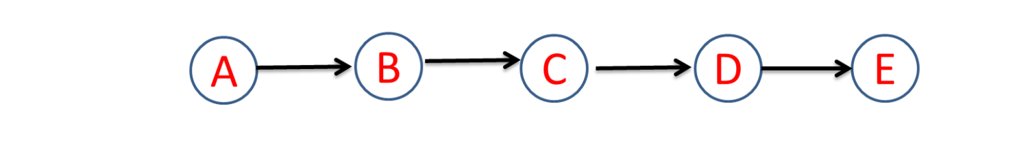
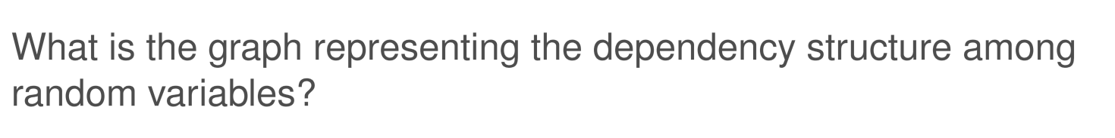
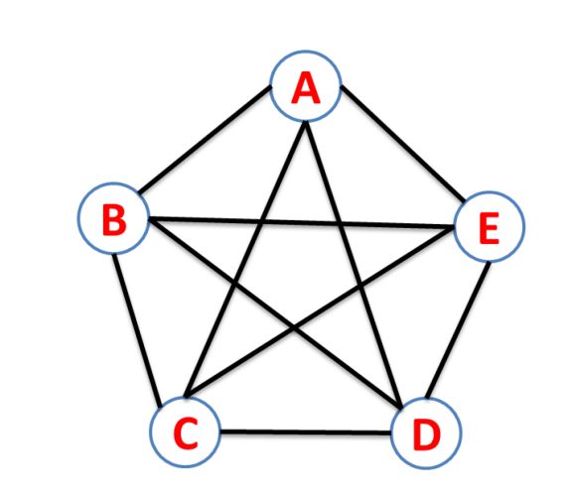

Slide 14
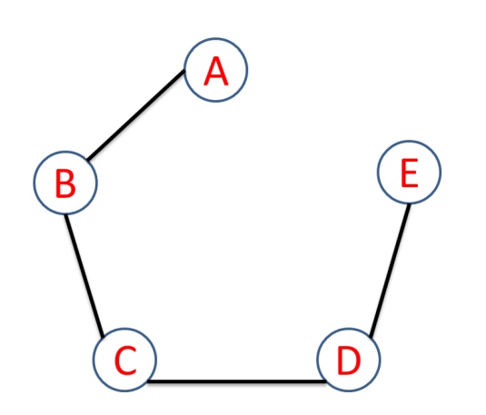

Slide 15
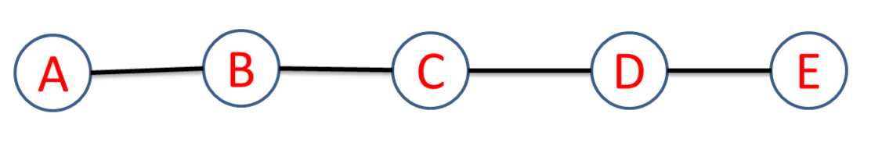

Slide 16
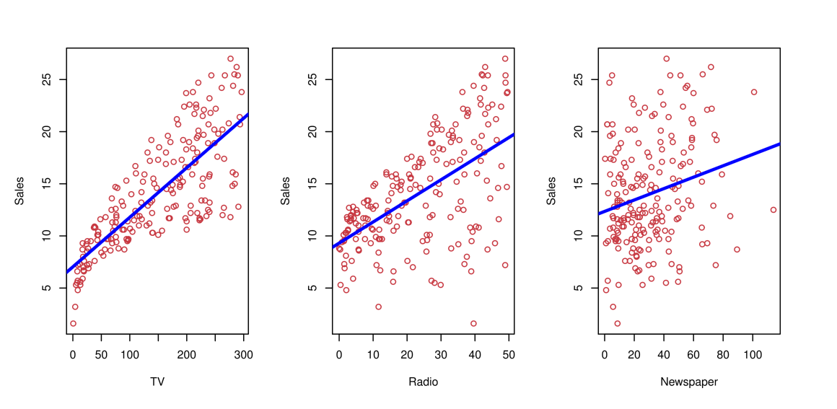
Sale-Advertising
Sales of a product in 200 different markets
Expense on TV, radio, and newspaper in these markets

Slide 17
What can you do for the data?
Can we predict Sales using the three expenses?

Slide 18
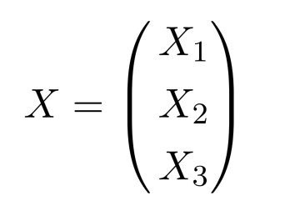
Notation
We wish to predict sale. We refer it to be the response Y
TV is a feature (input) which we can control. We denote it X₁. Similarly, Radio as X₂ ,and so on. We can refer to the input vector collectively as
Now we can write our model as
Y = f(X)
Y = f(X) + ε
Here f is some fixed but unknown function.

Slide 19
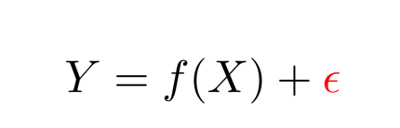
Errors in Machine Learning: World is Noisy
World is too complex to model precisely
Measurement error may not be avoidable
Many features are not captured
The error is where the statistics kicks in. Confidence interval, etc….

Slide 20
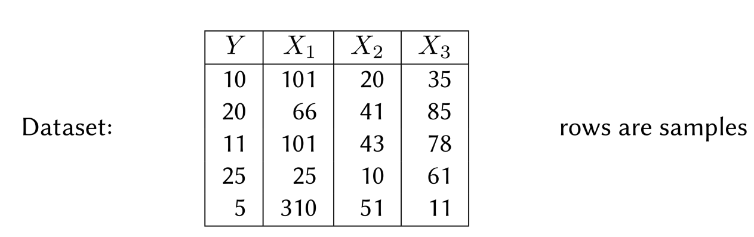
Market 1
Market 2
Market 3
Market 4
Market 5

Slide 21
Supervised Machine Learning Algorithm
Input:
Training data-set with features (X) and targets (Y)
Output:
Prediction function f

Slide 22
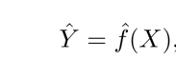
Why Estimate f?
Prediction: Make predictions about future:
Inputs X are readily available, but output Y is hard to obtain
Inference: Understand the relationship
what kind of ads work？ Why?

Slide 23
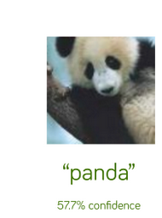
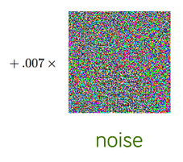
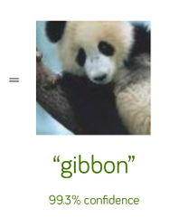
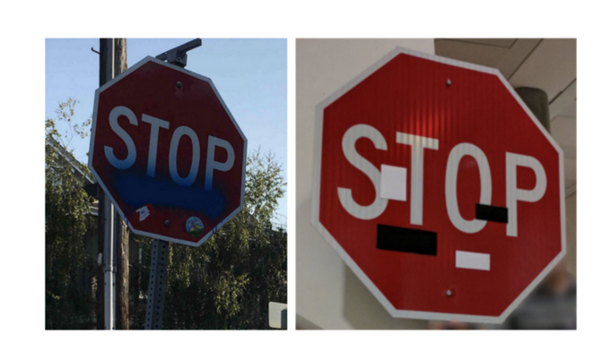
Inference is important

Slide 24
Prediction or Inference?
Application | Prediction | Inference
Identify risk of getting COVID
Predict effectiveness of COVID vaccine
Recognize hand-write txt
Speech recognition
Predict Stock prices

Slide 25
Prediction or Inference?
Application | Prediction | Inference
Identify risk of getting COVID | x | x
Predict effectiveness of COVID vaccine | x | x
Recognize hand-write txt | x
Speech recognition | x
Predict Stock prices | x | x

Slide 26
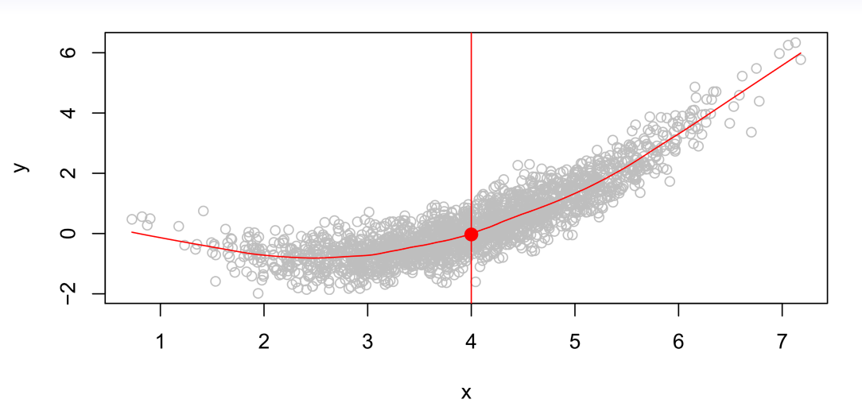
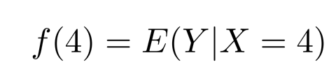
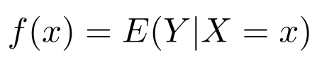
Is there an Ideal f(X)?
Given X = 4, what is ‘the best’ prediction for Y? or what can an Oracle say?
A good value is
where E(Y|X = 4) is the expected value of Y given (condition on) X = 4.
This is called the regression function or Oracle function.

Slide 27
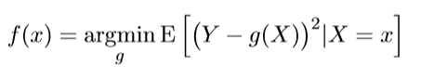
The regression function f(x)
The regression function is also defined for vector X as
is the best predictor of Y given x in what sense?
It is the best for the mean-squared prediction error over all function g(.) at all points X = x.
Q: Let’s prove it.

Slide 28
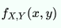
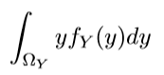
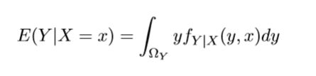
Recap
Given two random variables X and Y with joint probability density function
E(Y) =
E(Y|X = x) =?
E(f(Y) – g(X) | X = x) = ?
Notes:
Here is a note

Slide 29
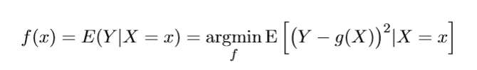
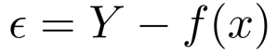
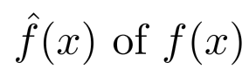
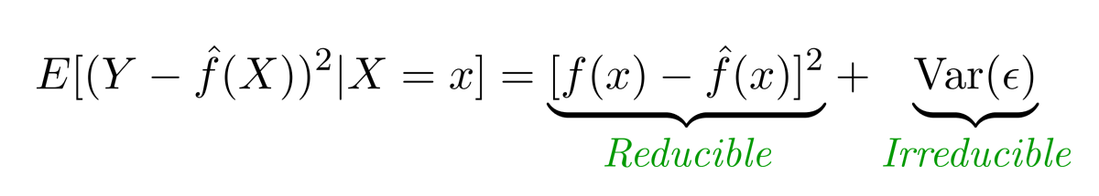
The regression function f(x)
It is the best predictor of Y with regards to mean-squared prediction error over all function g at all points X = x.
is the irreducible error. Even if we knew f(x), we will still make errors in prediction. What cause this?
For any estimate , we have

Slide 30
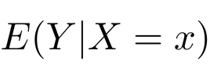
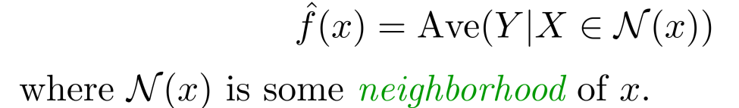
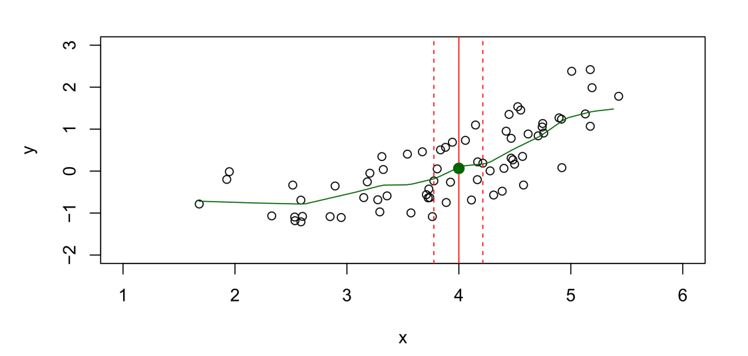
How estimate f?
Training Data:
However,….we have few if any data points with X = 4 exactly.
So..we can’t compute
Relax the definition and let

Slide 31
How estimate f?
Can we use y value to calculate the neighbors?

Slide 32
Nearest neighbor averaging can be pretty good for small p (p ≤ 4, p is the number of features) and large N (sample size).
Nearest neighbor methods is not good for large p.
Reason: the curse of dimensionality. Nearest neighbors tend to be far away in high dimensions.
We need to get a reasonable fraction of the data to average— e.g. 10%. Why?
A 10% neighborhood in high dimensions need no longer be local, so we lose the spirit of estimating E(Y | X = x) by local averaging.

Slide 33
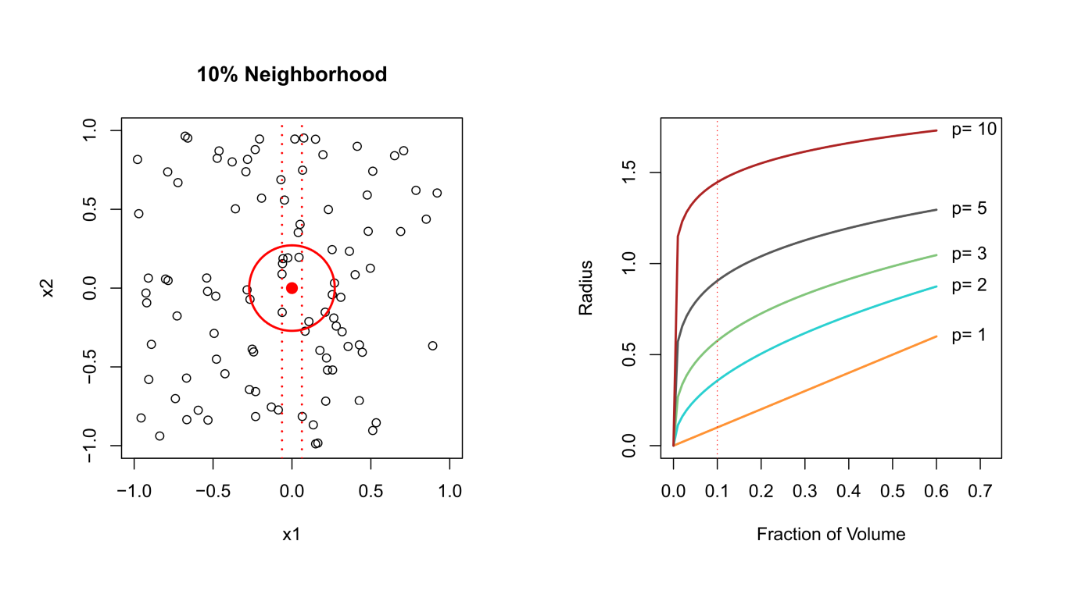
The Curse of Dimensionality

Slide 34
Any other Drawback?

Slide 35
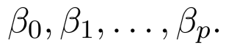
Parametric Methods
What assumption do we make for Nearest neighbor method? Any thing about f?
It is a Non-Parametric Methods.
What additional assumptions can we make?
The linear model is an important example of a parametric model:
A linear model is determined by the p + 1 parameters
A linear model often serves as a good and interpretable approximation to the unknown true function. Who knows. Why not try.
The structure-based approach just described is referred to as parametric. Reduce the search space.

Slide 36
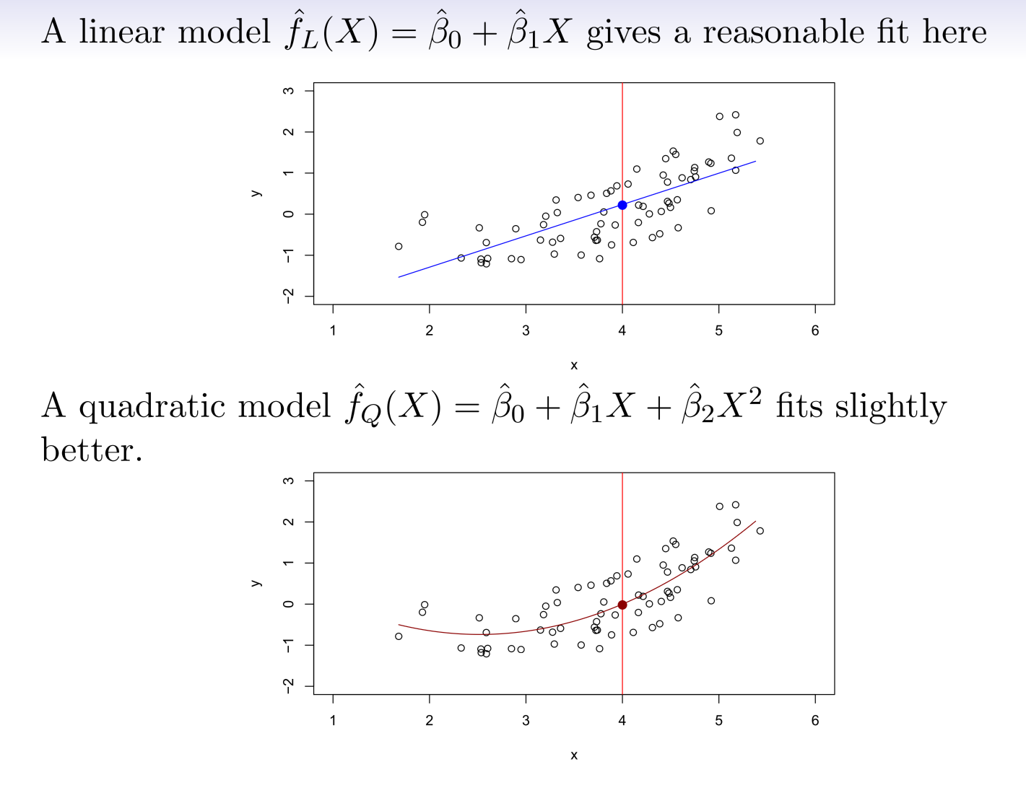

Slide 37
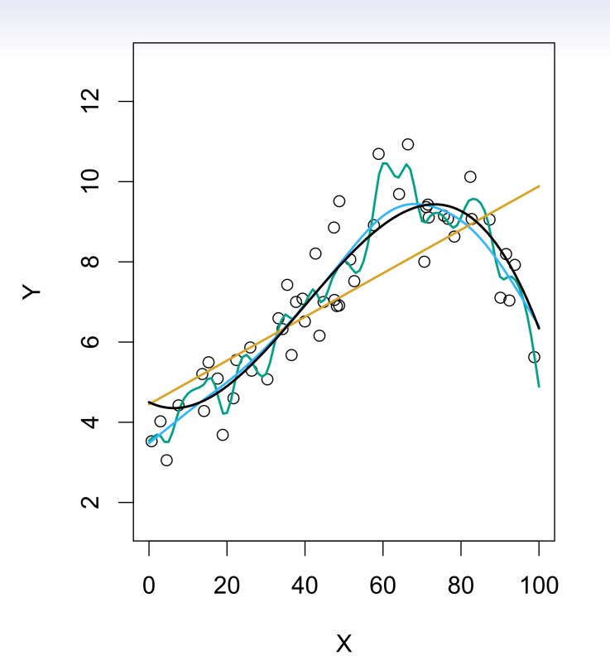
Some Trade-Offs
Prediction accuracy vs interpretability: Linear model vs Nearest Neighbors?
Good fit vs over-fit or under-fit.
Parsimony versus black-box.

Slide 38
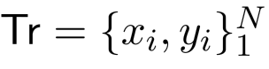
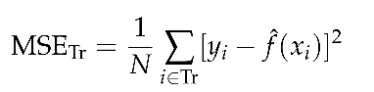
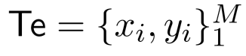
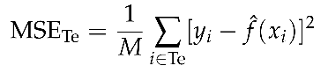
Assessing Model Accuracy
Suppose we fit a model to some training data , and see how well it performs.
We can compute the mean squared error (MSE) over Tr:
This may be biased toward more overfit models.
Instead， we should compute the MSE using fresh testing data
Important: the training and testing sample are iid.(Independent and identically distributed. )

Slide 39
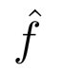
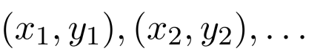
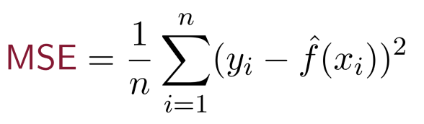
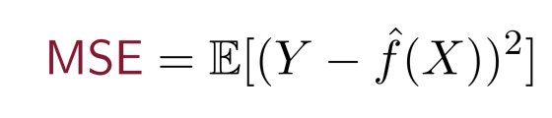
How Good are the Predictions?
Learned prediction function from training data
Testing data:
Mean Squared Error (MSE):
This is the estimate of
Important: the training and testing sample are iid.
Independent and identically distributed.

Slide 40
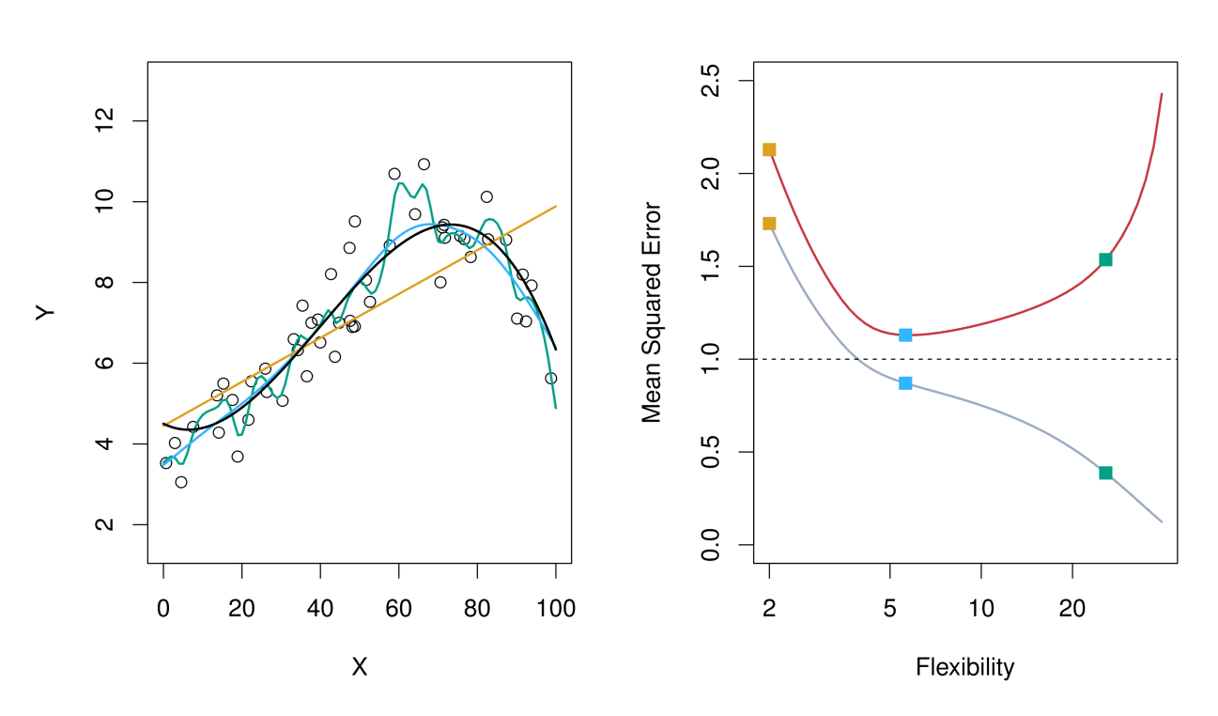
Do We Need Test Data?
Why not just test on the training data?
Gray line: training error, red line: testing error
Black line: truth; Orange, blue and green curves correspond to fits of different flexibility.

Slide 41
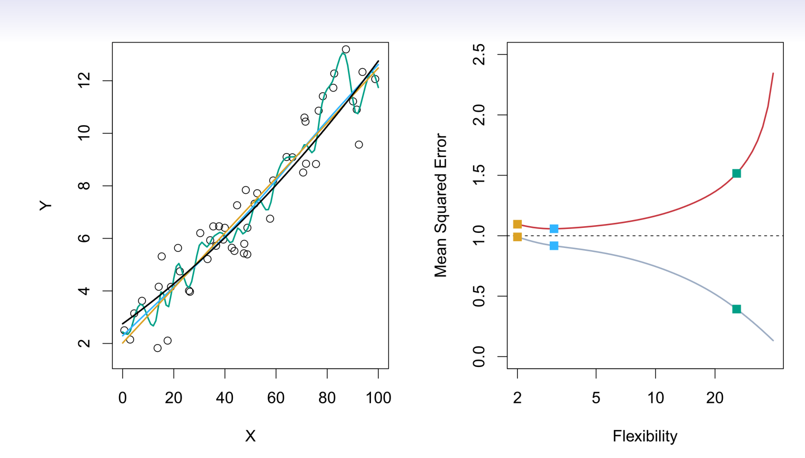
Do We Need Test Data?

Slide 42
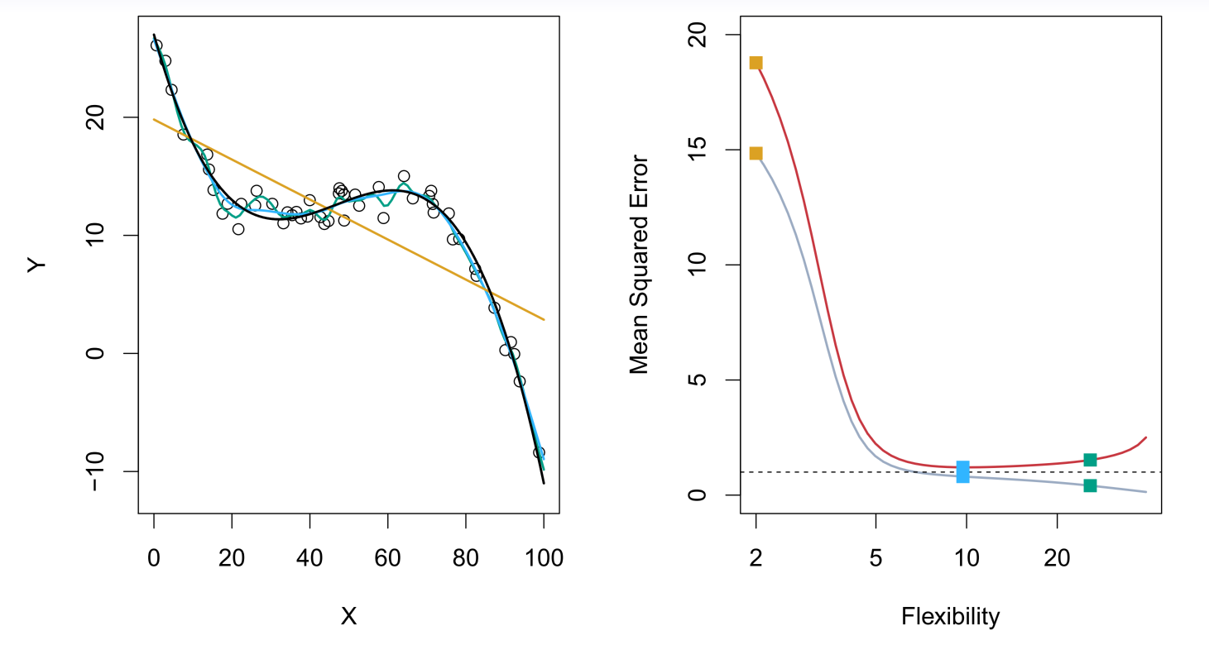
Do We Need Test Data?

Slide 43
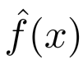
Bias-Variance Trade-off
Tr₁
Tr₂
Tr₃
X | Y
10 | 1
12 | 2
19 | 1
X | Y
9 | 1.1
11.1 | 2.2
13 | 3
X | Y
9 | 1.1
11.1 | 2.2
13 | 3.4

Slide 44
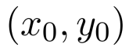
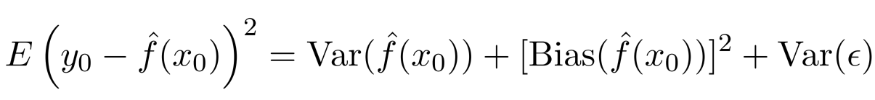
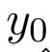

Bias-Variance Trade-off
Suppose we have ﬁt a model to some training data Tr_{1.}
If we have another set of training data Tr₂ to fit a model, will be the same?
Let be a test observation drawn from the population. If the true model is
We have
The expectation average over the variability of and Tr (training data).
Typically, as the ﬂexibility of increases, its variance increases, and its bias decreases. Selecting the ﬂexibility based on average test error amounts to a bias-variance trade-oﬀ.
Bias: if you have many sets of training data, the average prediction differs from the truth.

Slide 45




Do We Need Test Data?

Slide 46


Slide 47



Classification Problems
Here the response variable Y is qualitative — e.g. email is one of
(ham=good email), digit class is one of . Our goals are to:
Build a classifier C(X) that assigns a class label to a feature unlabeled observation X.
Assess the uncertainty in each classification.
Understand the roles of the different predictors among

Slide 48





Classification: some details
How to measure the performance of a classifier in a training dataset Tr? We use the misclassification error rate:
where is an indicator variable that equals 1 if and 0 otherwise
Can we define it as ? ?
As in the regression setting, we are most interested in the testing errors associated
with a testing set :
.

Slide 49


Ideal Classifier
Is there an ideal C(X)?
Suppose the K elements in are numbered 1, 2, …, K. Let
These are the conditional class probabilities at x;
Then the Bayes classifier at x is
, which is the optimal classifier.

Slide 50

Ideal Classifier
Nearest-neighbor averaging can be used as before.
Also breaks down as dimension grows.

Slide 51

K-nearest neighbors in two dimensions
Idea: Use similar training points when making predictions
What is/are the parameters?
Is it parametric or non-parametric?

Slide 52

K-nearest neighbors in two dimensions

Slide 53

K-nearest neighbors in two dimensions

Slide 54

KNN: Training and Test Errors

